Slide 1

REVERSE ENGINEERING- ADVERTISEMENT
SATHANA RAMESH

Slide 2
HISTORY-COSMETICS
COSMETICS HAS ALWAYS BEEN IN PRACTICE.
WHILE THE WORLD MODERNIZES WE STILL BELIEVE IN LIGHER SAHDES AND EXTERNAL BEAUTY.
WOMEN HAVE ALWAYS BEEN THE VICTIMS/CONSUMERS
COSMETICS HAS ALWAYS TARGETED WOMEN
COSMETICS HAS ALSO BEEN USED AS A WAEPON TO KILL PEOPLE
COSMETICS IS JUST AN OUTER PROTECTION TO HIDE FLAWS.
YET,THEY ENHANCE OUR BEAUTY,HIGHLIGHT US AND MAKES US LOOK PRESENTABLE.

Slide 4
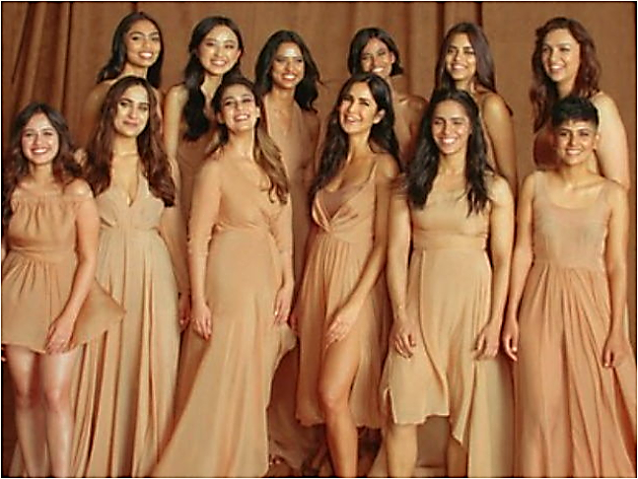
KAY BEAUTY-KATRINA AND NYKAA
Kay Beauty features Kolor, Kover and Kare ranges, where Kolor represents the colour cosmetics with eyes, lips & nails, Kover will include high performance face products and Kare encompassing the nourishing ingredients.

Slide 5
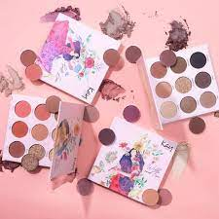
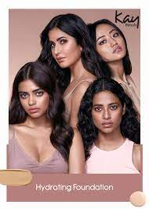
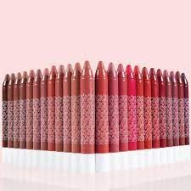
KAY FACTS

Slide 6
BRAND BY:
KATRINA KAIF
RELATABLE SONG AND FEATURING
HEALTHY FOR SKIN
SONG:
REAL AND FULL OF DAILY DAY TO DAY ACTIVITES
BRAND ENDOSSMENT:
KATRINA
NAYANTHARA
KUSHA KAPILA
CASTING DIVERSE WOMEN
CELEBRITY BRAND HYPE
AFFORDABLE AND REAL MARKETING BY THE BRAND OWNER
EASY BUYING:
E-BUYING

Slide 7
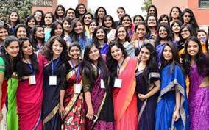

TARGET POPULATION:
YOUNG WOMEN
COLLEGE-STUDENTS
WORKING PROFESSIONALS
WOMEN WITH BEAUTY CONCIOUS

Slide 8
SURVEY:
A SURVRY IS BEING CONDUCTED.
CAMPS AND WORK SHOPS ARE CONDUCTED.
PRODUCTS WERE GIVEN TO THE TESTING SUBJETS AND TETS WERE CONDUTED ONCE THE PRODUCT IS AUTHOZED AND HAS CLEARED ALL TESTS BY GOVERNMENT.
TESTERS ARE REGULARY MONITERED AND DATABASES ARE MAINTAINES.
ADVERTISEMENT AND ADDJUSTMENTS ARE MADE ON AND IN PRODUCTS BASED ON SURYEY AND DATA.
SURVEY GROUP: 15-60 AGE GROUP

Slide 9
DATA COLLECTION:
SURVEY 1:
LOCATION:CHENNAI
METHOD:AWARENESS CAMP AND WORKSHOP
SURVRY 2:
LOCATION:MUMBAI
METHOD:BEAUTY CAMPAIGN
SURVEY 3:
LOCATION: DELHI
METHOD:AWARENESS PROGRAM AND BEAUTY CAMPAIGN

Slide 10
HYPOTHESIS TESTING:
H0: PRODUCT QUALIFIES ALL THE CLAIMS BY THE BRAND
H1: PRODUCT DOESNOT QUALIFY ALL THE CLAIM BY THE BRAND
TEST PERFORMED: CHI SQUARE TEST
Y- SALES (DISCRETE)
X-AGE GROUP (DISCRETE)

Slide 12
INFERENCES:
FROM THE GRAPH AND DATA WE INFER THAT:
WOMEN IN AGES 20 TO 40 HAVE A LOT OF INTREST AND AGREE WITH ALL CLAIMS.
WOMEN IN AGE 15 TO 20 ALSO SHOW SLIGHTLY MORE INTREST THAN THE WOMEN AGE 40 TO 60
WOMEN IN AGE BETWEEN 40 TO 50 EVEN SHOW MORE INTEST THAN THE SUCCEEDING AGE GROUP.
WOMEN OLDER THAN 50 SHOW LEAST INTREST IN THE PRODUCT.

Slide 13
RESULT:
WE CAN INFER THAT H0 IS TRUE AND WOMEN IN AGE 20-40 ARE THE MOST INTRESTED IN COSMETICS.
WE CAN ALSO CONCLUDE THAT THE ADVERTISEMENT CREATED BY THE BRAND IS JUSTIFIED AND IS TRUE THAT THE ADVERTISEMENT ATTRACTS THE YOUNG AUDIENCE AND WOMEN.

